Slide 1


The Great Wall of China
FIRE

Slide 2

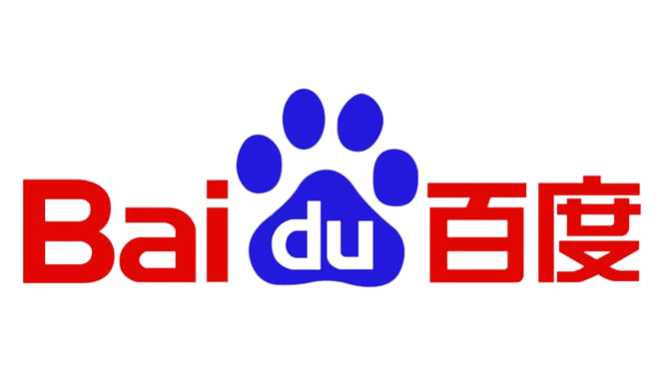









Our Apps VS Their Apps

Slide 3
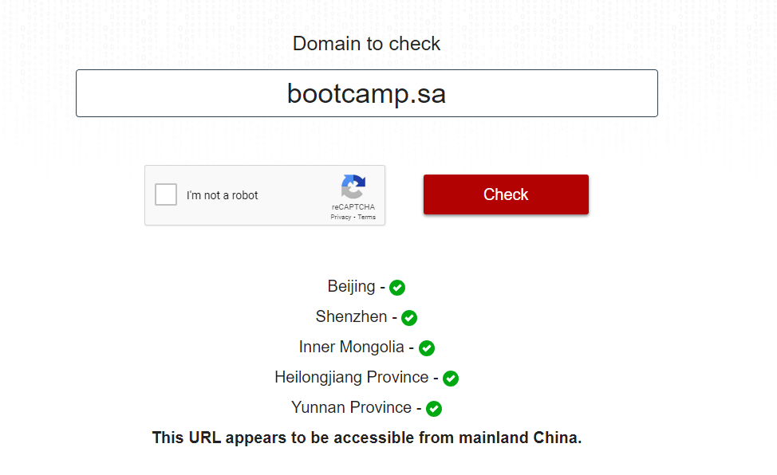
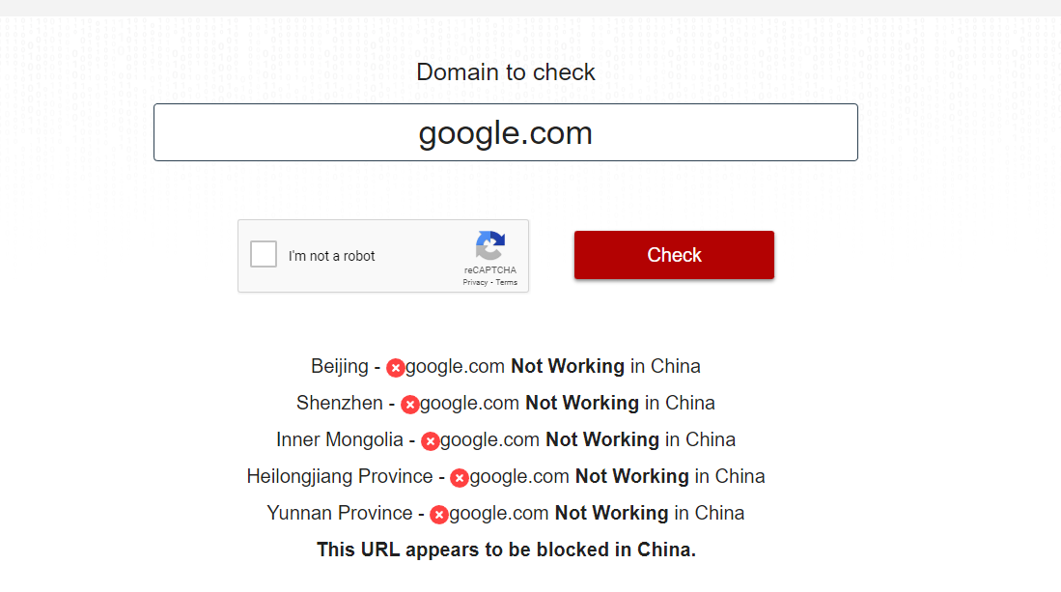
https://www.comparitech.com/privacy-security-tools/blockedinchina/

Slide 4

The great firewall of China
Khalid Alghamdy
Yasser AlOmar
Meshari AlQahtani
Razan AlTamami

Slide 5

Timeline
Jan 1983
The internet is created
1994
The Internet makes its way to China
1998
Golden Shield Project begins taking form
1988 - 2006
2006 - 2008
Introduced IP Blocking and DNS Poisoning
TCP DROP and VPN crackdown
2006 – Present
Optimization and improvement of the wall and it’s subsidiary technologies

Slide 6

What is the golden shield project?
What we call the firewall is a subset of the golden shield project.
The rest of the golden shield project focuses on other ways to control and censor information such as:
Surveillance software on computers
Web cameras
Regulation of ISPS

Slide 7
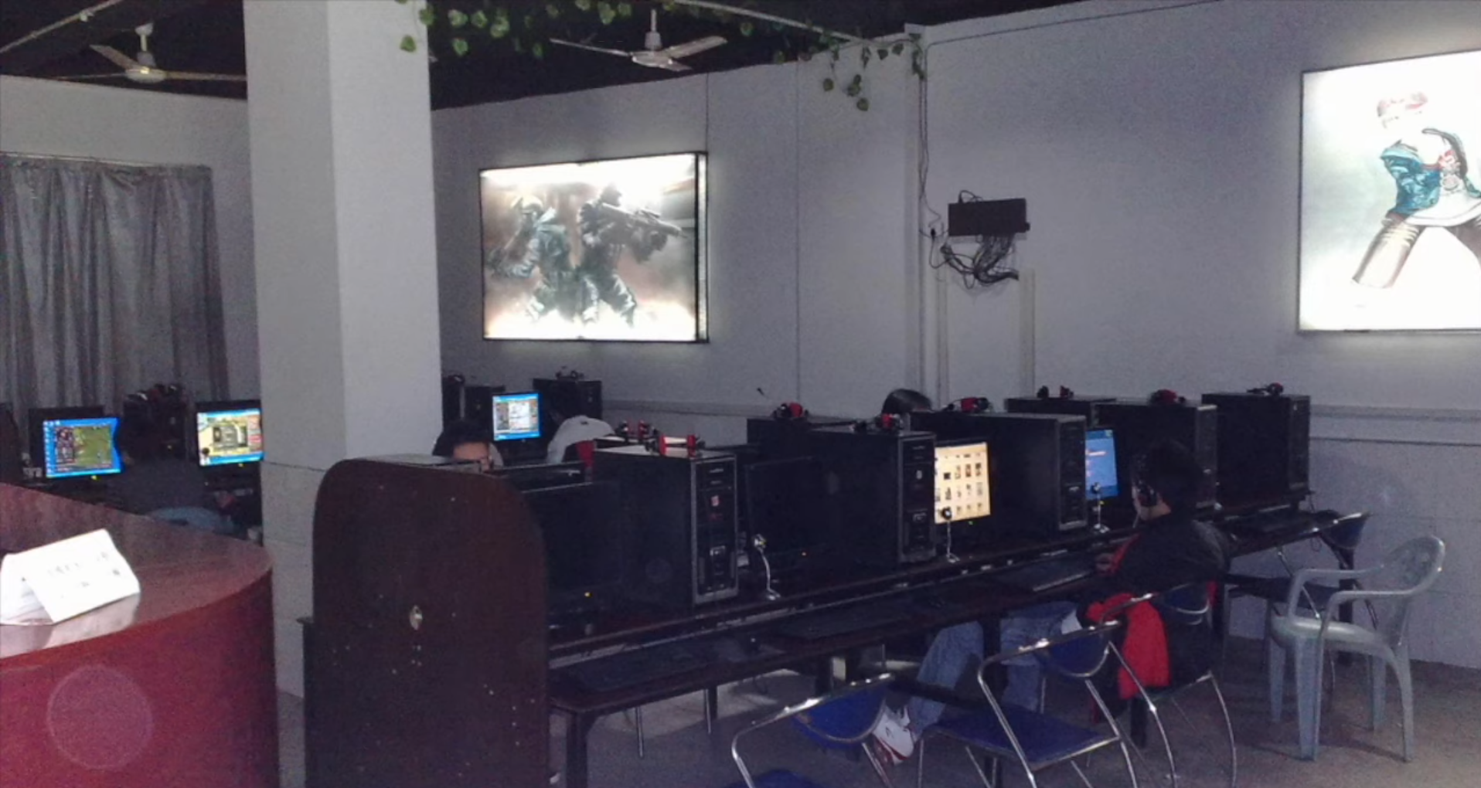
Example of the golden shield project in action
Internet Café owners had to install surveillance software on their computers
They also had to report any “behavioral” problems to the government

Slide 8
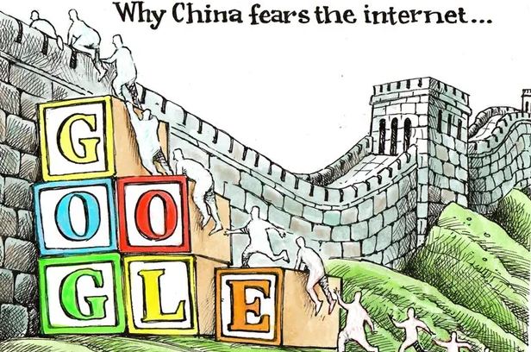


Goals of the golden project:
Opposing the basic principles as they are confirmed in the Constitution.
Jeopardizing the security of the nation, divulging state secrets, subverting state power, or jeopardizing the integrity of the nation's unity
Harming the honor or the interests of the nation
Inciting hatred against peoples, racism against peoples, or disrupting the solidarity of peoples
Disrupting national policies on religion, propagating evil cults and feudal superstitions
Spreading rumors, disturbing social order or disrupting social stability
Spreading obscenity, pornography, gambling, violence, murder, terror, or abetting the commission of a crime
Insulting or defaming third parties, infringing on the legal rights and interests of third parties
Containing any other content prohibited by law or administrative rules

Slide 9
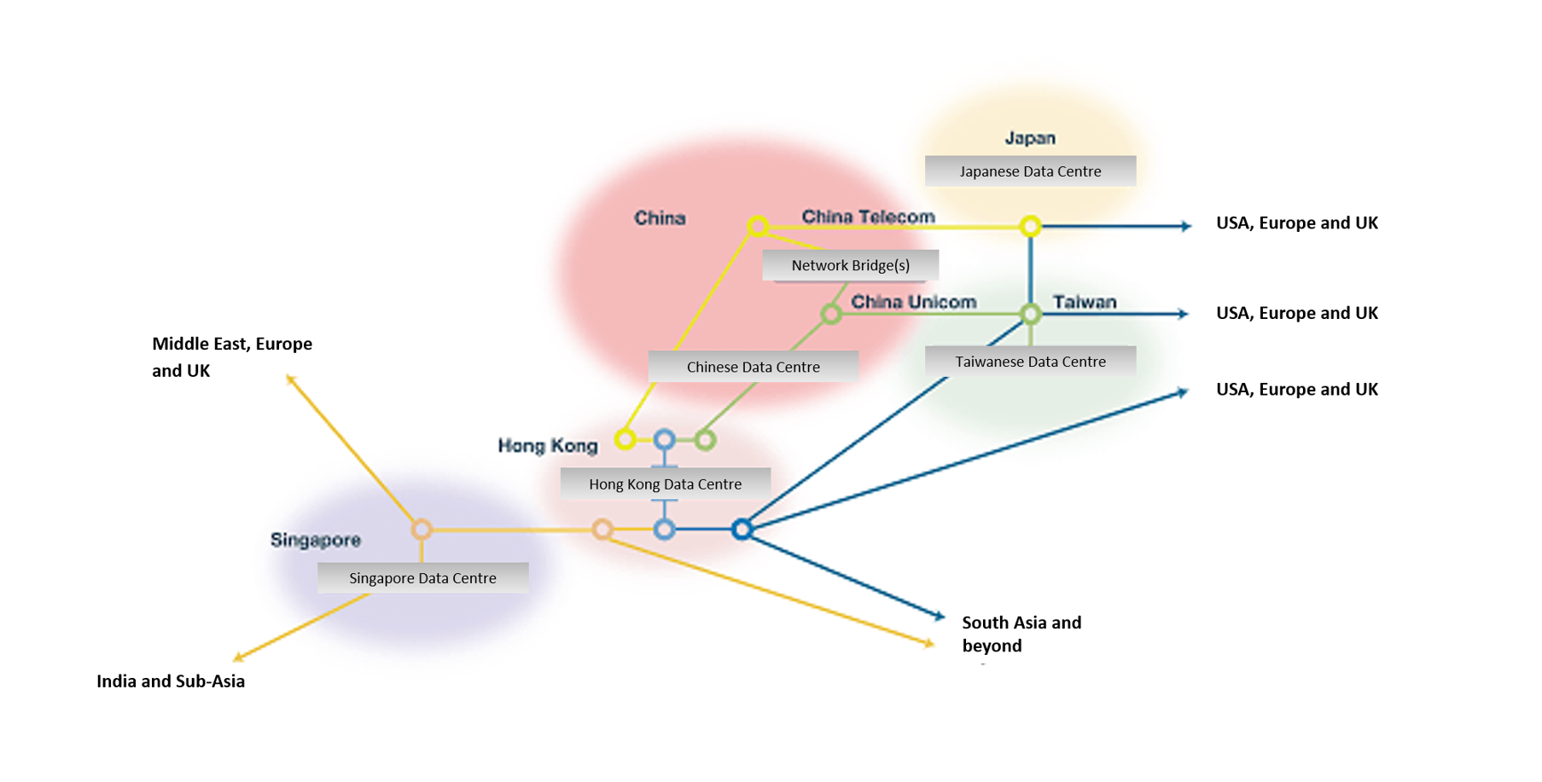
Topology
All data that flows into or out of China must go through one of the 14 Internet exchange points in China
All Internet exchange points are STATE owned
After that it gets routed to the appropriate ISP

Slide 10


Censorship methods
How does the firewall work?

Slide 11

Plan A: IP BLOCKING

Slide 12

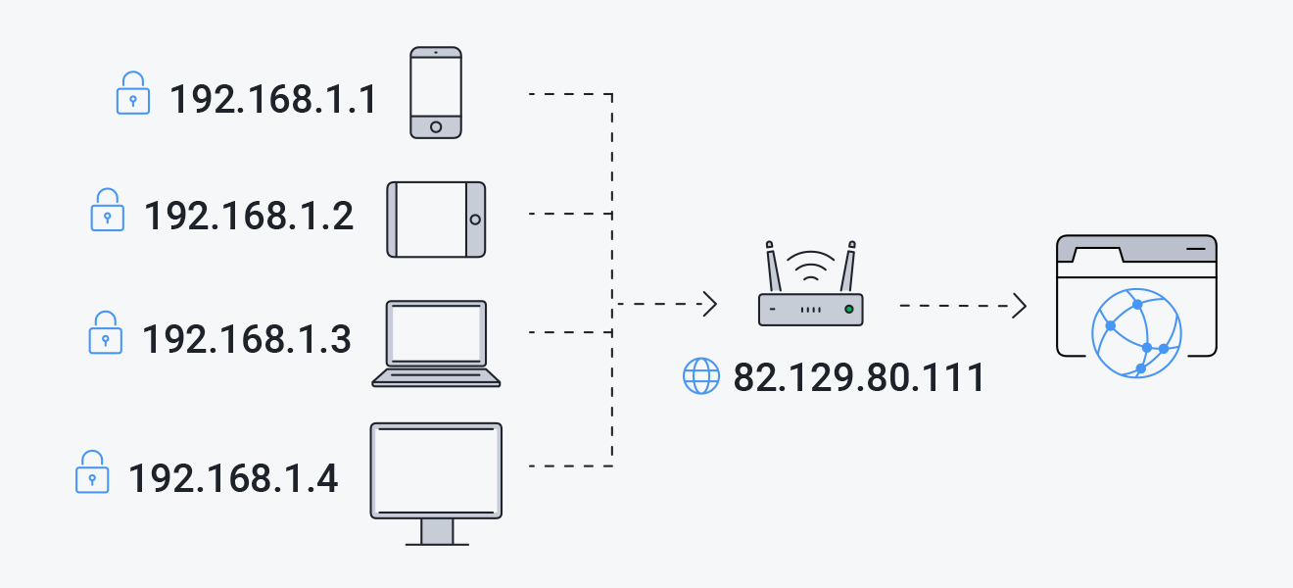
What is an ip address?
Each device that is connected to the Internet has a uniqueIP Address that can roughly map out where that device is connected from
That Ip address is assigned by your internet service
The public IP address is what is shared with the world not the private one.
Each device on a network has a private IP address, and the router has a public IP address to communicate with the rest of the internet.

Slide 13
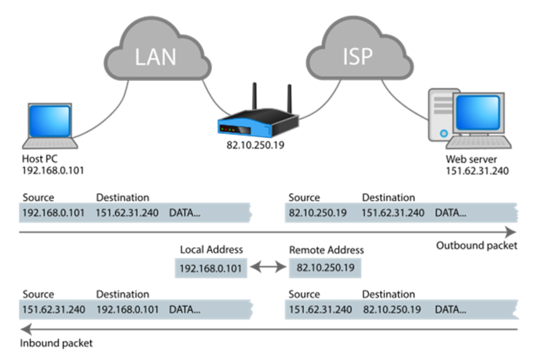
Network packet structure
An Internet packet consists of a header and a payload.
The payload is the actual data sent, the header however, is what we are interested in. It contains the source IP address and the destination IP address.

Slide 14
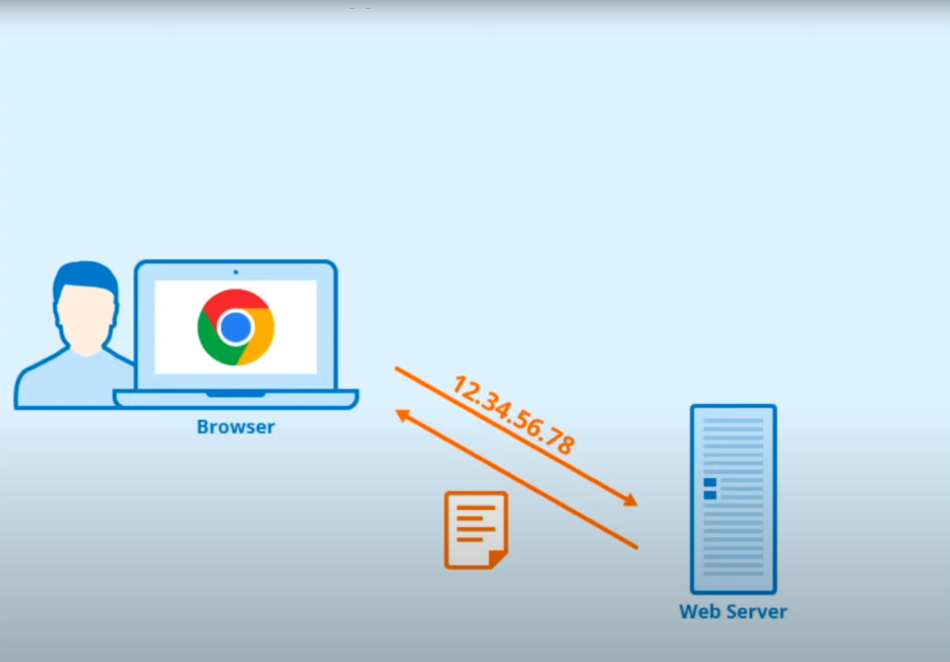
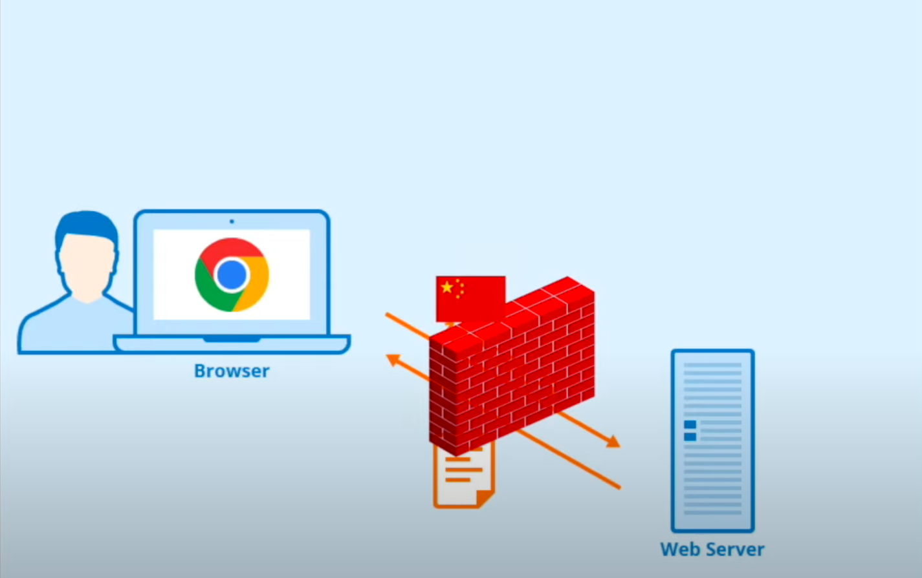
IP blocking procedure
China has a list of blocked IP addresses.
Internet packets contain source and destination addresses
All packets make their way to the ISP first
Internet packet is unpacked and destination address is crosschecked with the blocked IP list
If the destination address is in the blocklist it either reroutes to another address or sends that data to the void which ultimately leaves the sender in constant state of loading.

Slide 15

Plan b: DNS POISONING

Slide 16
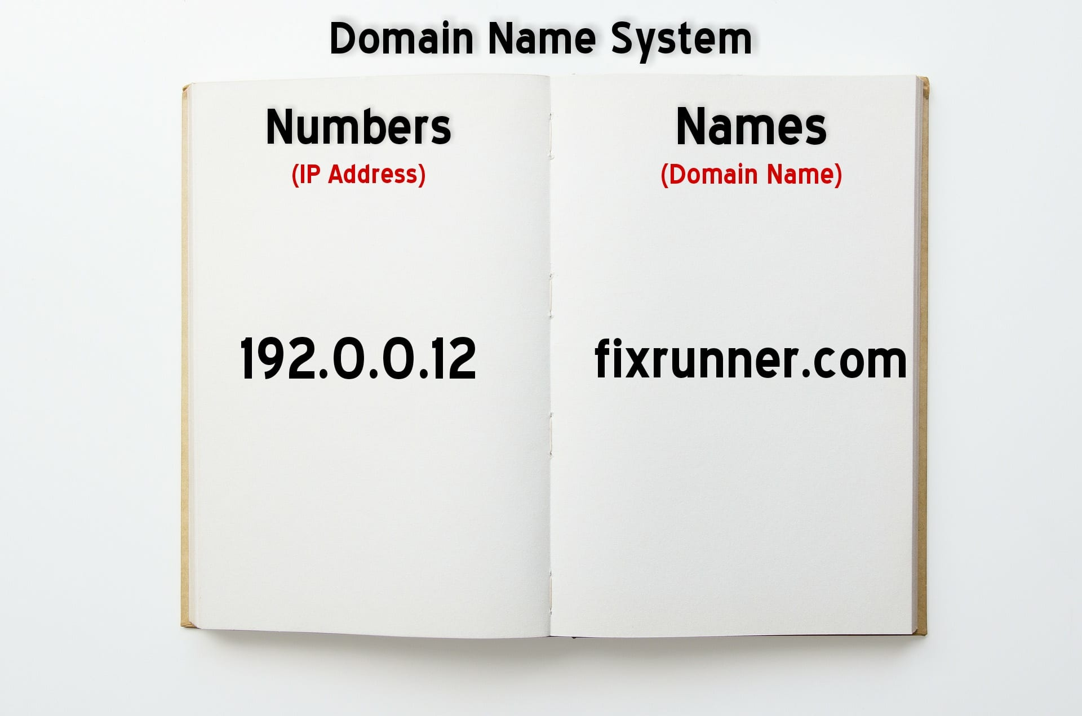
DNS (Domain Name system) can be thought of as the phonebook of the internet. It used to translate domain names to Ip addresses. Without DNS you’ll have to memorize the Ip address of every website you want to use.

Slide 17
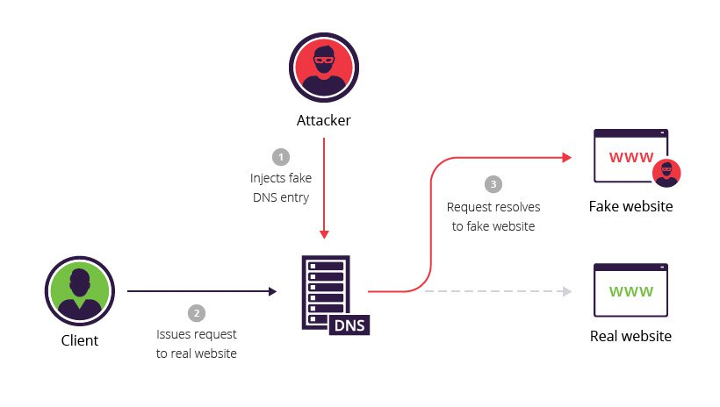
Procedure:
The user enters the domain name in the search bar.
The request is then sent to a DNS resolver which are servers in charge of tracking down the IP address that corresponds to that domain name
The requester then gets routed to that address.
The attacker in this case is China’s censorship
China has a DNS blocklist of over 15000 keywords

Slide 18

Plan c: TCP DROP

Slide 19
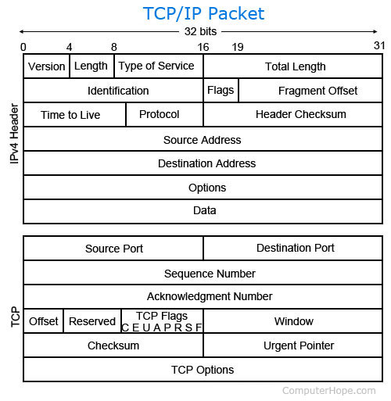
What is TCP?
TCP stands for Transfer control protocol. It’s an agreed upon set of “rules” that govern the transfer of internet packets.

Slide 20
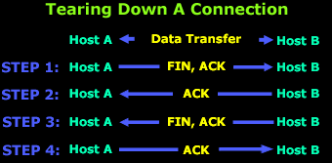
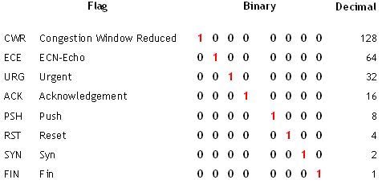
An example of tcp transfer
User finishes sending data: Sends final packet with FIN and ACK set to 1
Host B send a packet back with ACK set to 1
Host B then sends it’s own end of transmission packet with FIN and ACK set to 1
Host A send a packet back with ACK set to 1.
Transmission successfully finishes

Slide 21
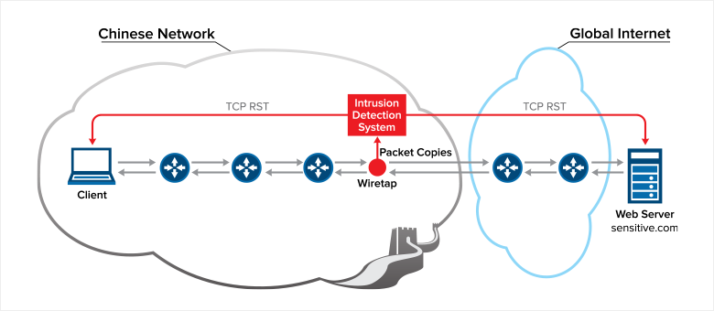
How does China abuse the TCP system?
Through the RST flag in the TCP protocol.
Remember all connection eventually led to one of 14 internet exchange points.
1 – A person in China enters a website that contains blocked keywords.
2 – On a hardware level an internet packet is sent requesting access.
3 – That packet will propagate throughout the network on it’s way to its destination
4 - subsidiary machines set up by ISP’s will intercept that packet and start scanning the website for blocked keywords
5 – If it detects any blocked keywords and since it’s on the same network it will send a series of packets both ways with the RST flag set to 1.
6 – Both side interpret it as a genuine packet from the other end requesting to kill the connection and thus stops transmitting.

Slide 22


“climb over the wall”
There Are Some Tools To Bypass The Firewall:
VPNs ( Virtual Private Network )
Proxy servers
Freegate, Ultrasurf, Psiphon and Lantern.
Tor.
I2P or Garlic Routing.
Encrypted DNS.

Slide 23
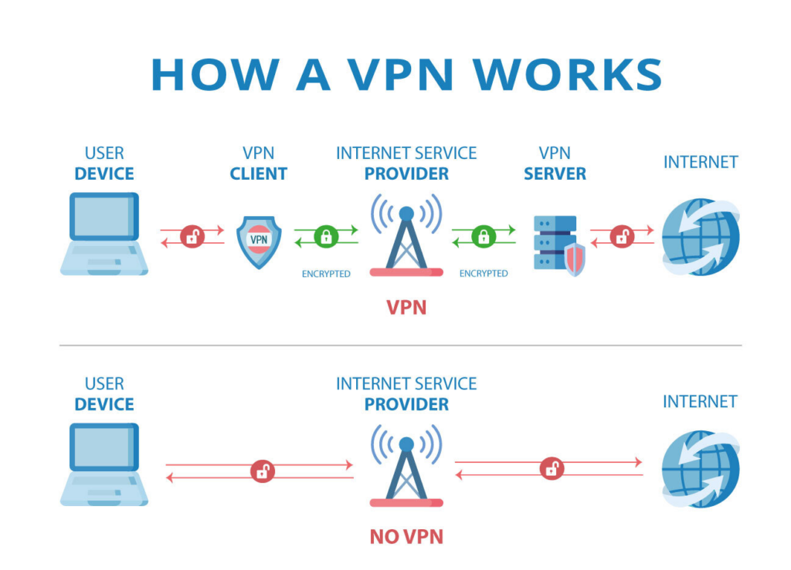

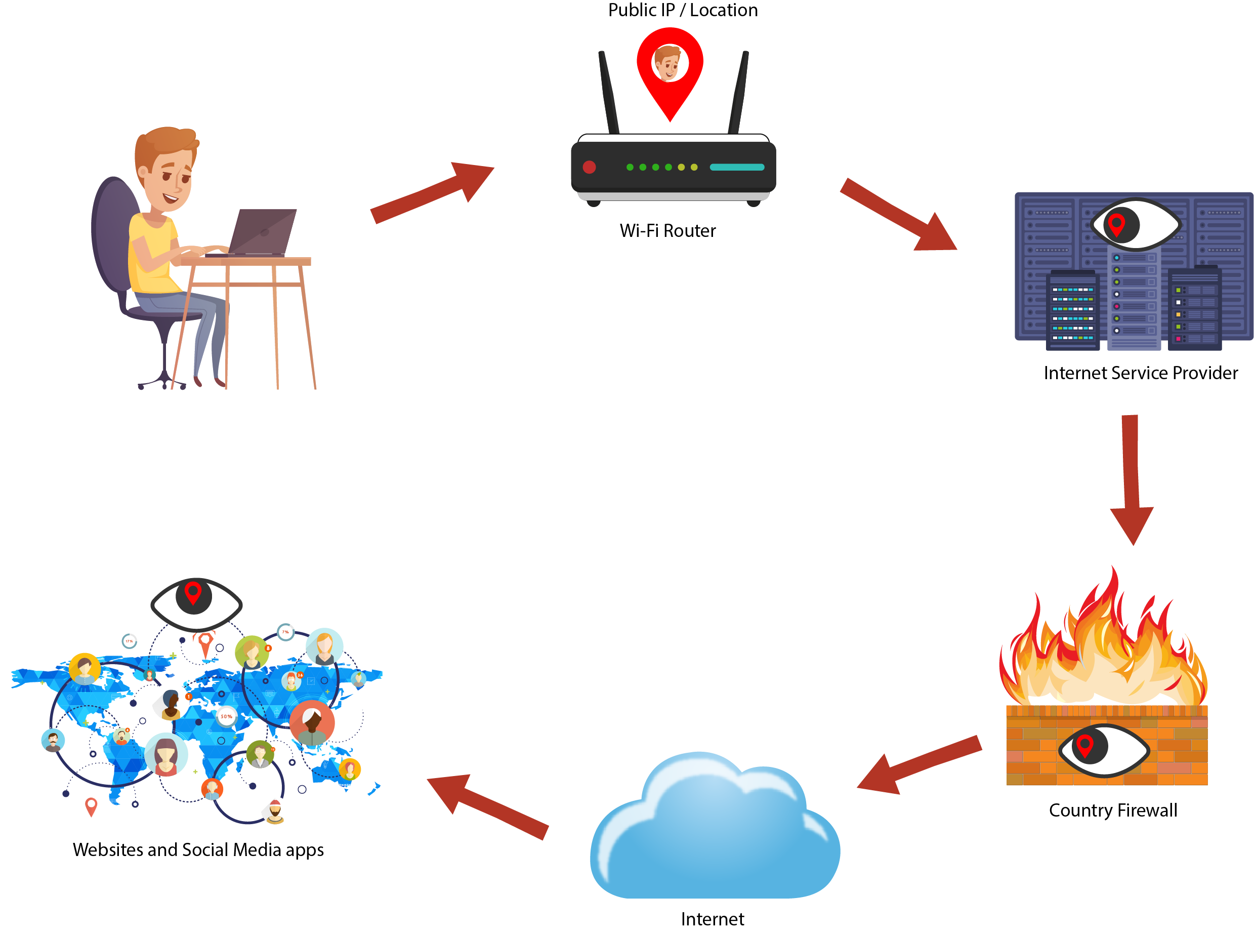
vpn
A VPN encrypts the traffic and sends it through a third-party server.
since the data is encrypted, the Chinese firewall can’t inspect it so it lets it through.
However, Firewall has gotten a lot smarter, and has good understanding of common VPN protocols.
It employs the use of AI to detect VPN traffic.
For example: if 99% of the data stream is routed to 1 address and is encrypted then it’s most likely a VPN
It can also recognize most free VPNS.
Government caught in 2017 illegal vpn selling through TaoBao.

